Slide 1
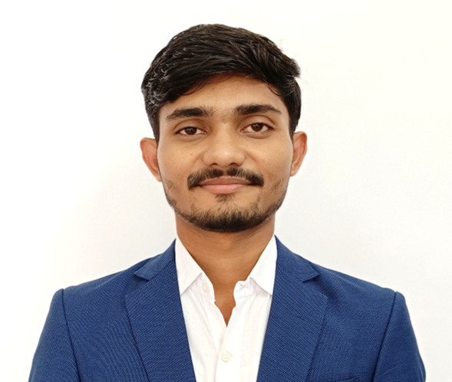






Saurav Kumar
Business Analytics Associate Consultant
RESUME SUMMARY
saurav22118@gmail.com
Performance-driven and resourceful professional with ~2 years of experience in providing research, analytics, consulting and implementing solutions for life science industry clients.
Proven track record in driving client success and retention by offering high quality, personalized solutions targeting specific client needs. Instrumental in leading teams and collaborating across functions to execute projects and meet critical targets.
+91-9304864591
Gurugram, Haryana
linkedin.com/in/saurav-kumar-55a0b5158
EXPERIENCE
SKILLS
Problem Solving
Client & Team Management
Business Analytics
Commercial Analytics
Sales Operations
US Pharma Landscape
ASSOCIATE CONSULTANT
ProcDNA Analytics, Gurugram, HR / Jan 2021 – present
Works as an Associate Consultant for ProcDNA’s Business Analytics team. Responsible for a cross-functional team of 4+ associates and their career progression
Handling client request management process for the entire team. Leading the planning and implementation of different commercial analytics and sales operations projects
Specialized in delivering actionable insights for launch & mature product cases based on client requirements
Extensive knowledge of both Medical and Pharmacy dispensed branded drugs in the US market leveraging varied claims, sales, and coverage data
Commercial analytics projects:
Patient, provider, and payer analytics support using APLD claims data
Patient Journey for three different dermatology indications (Psoriasis, Atopic dermatitis, and Seborrheic dermatitis)
Patient’s Persistency & Compliance analysis
Fulfillment, Abandonment, and the Rejection rate analysis
Epi model, Life-time value of a patient, etc.
Sales Operations projects:
Assisted with salesforce strategy for mature and new product releases, including sales reporting and operations, Early adopter analysis, targeting and call planning optimization, and incentive compensation (IC)
Completed daily ad hoc duties on projects with demanding deadlines to assist clients with daily business choices, as well as collaborated with leadership on new company plans and pitches
Assisted the client in conducting IC Health Checks to ensure that the IC methodology and plan are appropriate for the current market scenario and brand maturity and that sub-geographic bias is avoided
Led the development of the personalized IC dashboards on Tableau
Led initiatives to optimize & operationalize that had repetitive processes & built-in interim checkpoints for accurate deliverables
Contribution to the firm:
Managed the MS Office admin activities for the firm until the team expanded to support a full-time admin
Part of the recruitment team to expand the team and experience level for better delivery of the projects from 15 to 80 members in 1.5 year
Delivered training sessions on tools like Alteryx, Importance of Quality, Project & timeline management and business areas to new joiners
TOOLS
Alteryx
SQL
Tableau
AlignMix, Draw.io, Figma
MS Office (Outlook, Excel, PPT)
DATASETS
IQVIA LAAD Data
Xponent Sales Data
Xponent Prescriber Dynamics
MMIT, DDD, NPA
Promotional Data
EDUCATION
B. Tech (Production & Industrial)
NIT Jamshedpur
2017 – 2021
CGPA: 9.0/10
AWARDS
ProcDNA (2021 – 2022)
Problem Solving & Quality
Project Ownership, Data Knowledge & Blazing Fast Learning New Business Areas
Owning end-to-end Delivery & Client Relationship
OPERATION MANAGEMENT INTERN
GradSpace, Delhi / Apr 2020 – May 2020
INTERESTS
Worked directly with founders to develop core values & vision for GradSpace
Researched & documented all the steps involved in the process of getting an admission in the foreign universities

